Slide 1
What causes conflict?

Slide 2
How was the European view of land different from the American Indian view of land?

Slide 3
Who was Robert de La Salle?

Slide 4
Robert de La Salle
French Explorer
Lived 1643-1686
Explored North America
Sailed down the Mississippi River
Claimed a large area around the Mississippi River for King Louis XIV of France
Called the area Louisiana

Slide 5
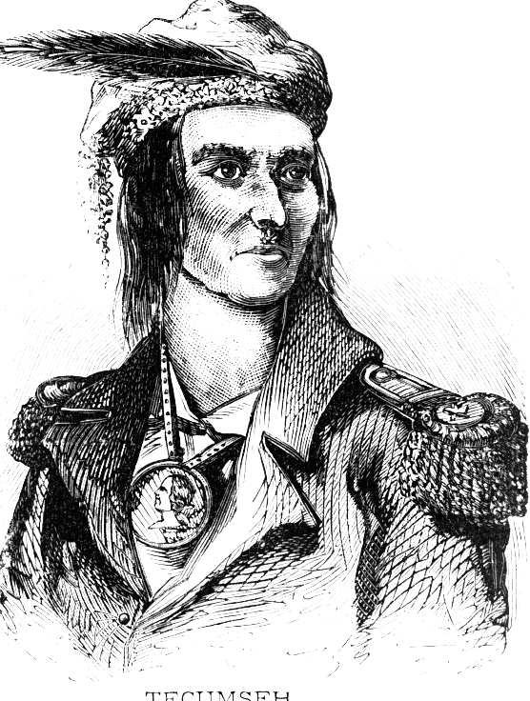
Who was Chief Tecumseh?

Slide 6
Chief Tecumseh
Leader of Shawnee
Lived 1768 – 1813
Military leader
Fought against the loss of native Indian lands

